Slide 1
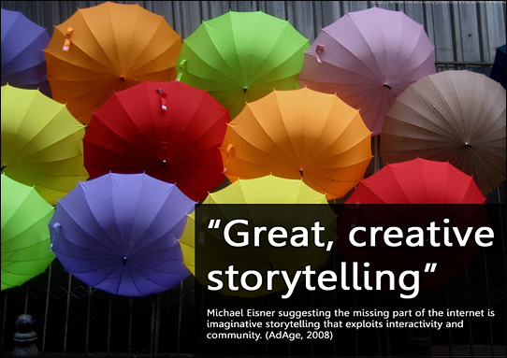
Using Imagery and Stories for Engagement and Impact
“The age old art of storytelling is one of the most effective tools leaders can use. But they need to pick their stories carefully and match them to the situation.”
Harvard Business Review

Slide 2
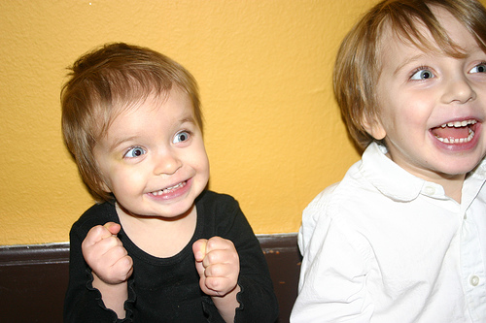
What’s Your Story?
Analysis of data is not sufficient…..even the Harvard Business Review agrees!
Being able to tell a compelling story of your work is critical to engaging others in sustaining improvements.

Slide 3
5 Elements Every Good Story Must Have
It must be about a person or group who’s struggles we can relate to.
The stakes are high and something has changed that compels the characters to change what they are doing. Typically the opening of the story sets this up.
Obstacles produce drama, frustration and conflict.
A turning point -- the characters can no longer do things as they have in the past.
A resolution: “they lived happily ever after”

Slide 4

What to Emphasize in Different Kinds of Story
Not all stories have the same purpose – to make our point clear, we can change our
Focus
Depth
Methods
(adapted from http://blogs.hbr.org/2014/05/10-kinds-of-stories-to-tell-with-data/).

Slide 5
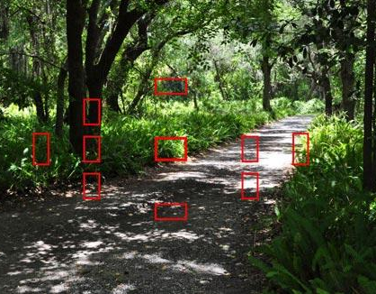
Focus
Focus of your story may be
What You Did
Why You Did It
How to Address an Issue

Slide 6
What Why How
What stories are like reporting stories—they simply tell what happened, less powerful for creating change.
Why stories go into the underlying factors that caused the outcome, higher power.
How to address the issue stories explore various ways to improve the situation identified in the what and the why stories, higher power.
A really complete story may have all of these focus elements.

Slide 7

Where to Put Your Energy
Focus on getting fast agreement on the “what”
Then spend more time and energy on why and how
Hint: Everyone involved in creating and telling the story use the same data.

Slide 8
Depth
Your story may be short, sweet and powerful – Like a CSI episode – short investigation, happy ending.
or
“Eureka” stories, often long, analytically-driven searches for a solution to a complex problem. When you solve it, you want to yell, “Eureka!” These types of stories are typically long, important, and expensive.
Both types of stories can be successful but be careful to notice your audiences’ tolerance and patience……..and calibrate your storytelling accordingly.

Slide 9

Methods You Used
Finally, some stories can be about the methods you used
Correlation
Causation
But don’t confuse correlation with causation!

Slide 10
How Does This Apply to You?
Introduce the main characters – who’s involved? Try to pick a main character to open the story with – a nurse, a patient….
Set the stakes – why does this matter?
What’s changed that requires a different course of action today than in the past.
Tell the truth about obstacles, barriers, conflict, frustration – this is where we can learn from you! It’s OK to be confused and messy at this stage.
Tell us the ending: we reduced UTIs and improved client’s quality of life.

Slide 11

How Does This Apply to You?
Start telling your story – notice what kind of story you are telling………..

Slide 12

But wait there’s more!
Great stories have catchy titles --
A good title is usually short, punchy and captures the mood and outcome of the story.
A good title helps listeners REMEMBER the important meaning of the story

Slide 13
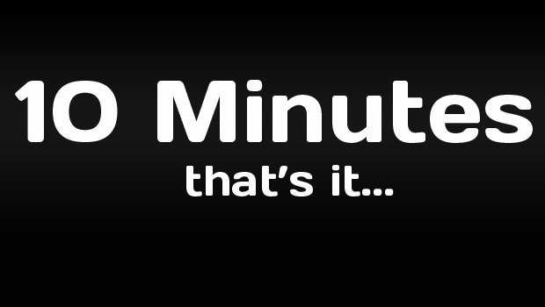
Write Your Story
10 Minutes!
Either by yourself, or with your group, write your story on the form in your packet using the tools we’ve just discussed

Slide 14
Jumpstart Storytelling with Thanks to Seth Kahan
Introduction 5 minutes
Go to your group number – huddle up – knee-to-knee – with your group
1st Story Table: 20 minutes
Each person shares their story in 120 seconds (2 minutes). Introduce yourself, set up the stakes, what, why and how did things happen, what’s the resolution and your story title.
Leave chairs and ONE person in each group. Everyone else go find a new group. 3 minutes
2nd Story Group: 12 minutes
New small groups are formed - all new faces. Storytelling repeated. Same story, different listeners, tell your story in 2 minutes or less.
Clusters & Chains: 5 minutes
Recall the story that most captured your attention. Stand up and find that storyteller and put your hand on that person’s shoulder.
Those with most hands on their shoulders (i.e., the most people have selected them) will be asked to share their stories with the whole - they are the group storytellers.
Plenary Storytelling: 10 minutes
The group storytellers tell their stories. Each story is followed by 20 seconds of silence, rather than applause. Audience encouraged to quietly notice how the story engages them.

Slide 15
For More Information
http://storytellinginorganizations.com/articles/
www.stevedenning.com
Steve Denning is a well-known organizational storytelling expert
http://www.visionaryleadership.com/site/
Seth Kahan writes a regular column on storytelling for Fast Company. His Jumpstart Storytelling technique can be found at: http://www.visionaryleadership.com/free-resources/culture-the-power-of-storytelling-to-jumpstart-collaboration.php#sthash.9gsc7x7U.dpuf

